Slide 1



The Sky's the Limit elevating Lufthansa's Instagram Marketing through data-driven insights
Ballegeer Matteo 01900129
De Rocker Yaël 01904043
Janssens Wannes 01905583
Peire Julian 01900199
Willemen Tom 01900194

Slide 2
01
Lufthansa vs SINGAPOREAIR: A general comparison

Slide 3

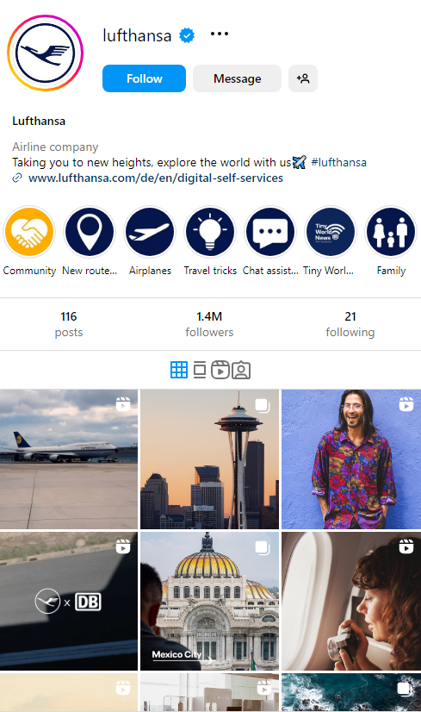
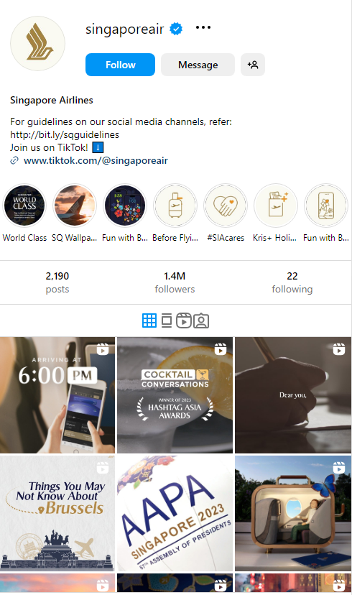
A qualitative comparison
General
Comparison
TikTok link
Story highlights
Story highlights
(Recently removed old posts)

Slide 4
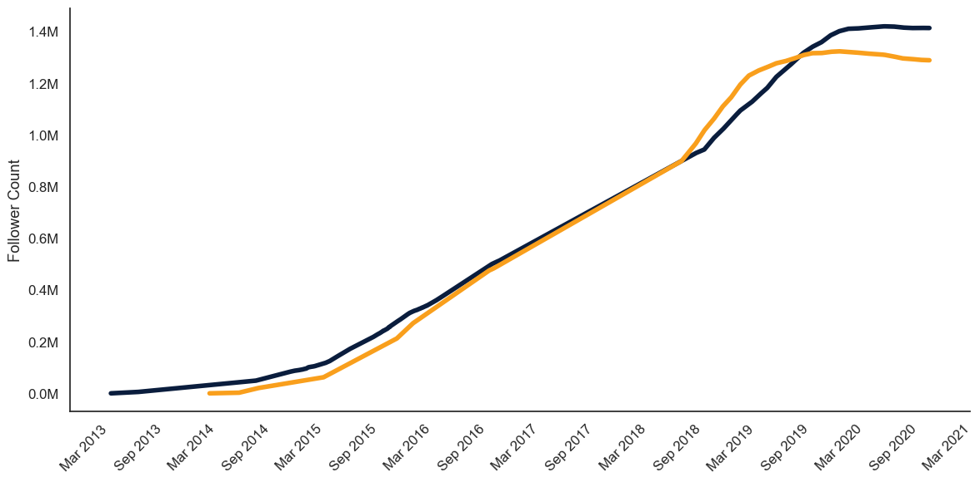
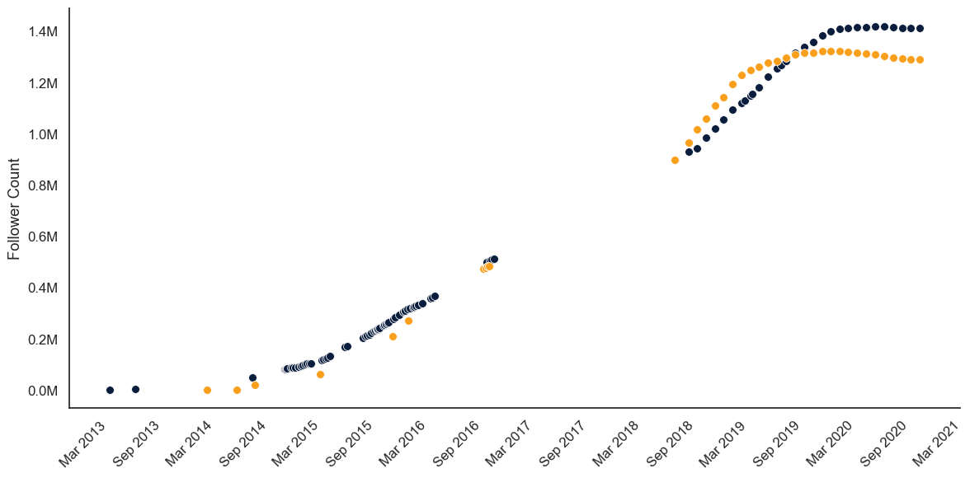


Both COMPANIES share a Similar growth story
General
Comparison
Follower growth over time¹
2021 Industry comparison²
Emirates: 5.5M
Qatar Airways: 3.4M
LATAM Airlines: 1.8M
Turkish Airlines: 1.8M
Etihad: 1.7M
Lufthansa: 1.4M
KLM: 1.3M
Singapore Air: 1.2M
Garuda Indonesia: 1.1M
Air France: 1.0M
¹ Approximation using historical snapshots of follower counts: https://web.archive.org/
² https://www.id1.de/2021/05/11/20-best-airline-brands-on-instagram-in-2021/

Slide 5
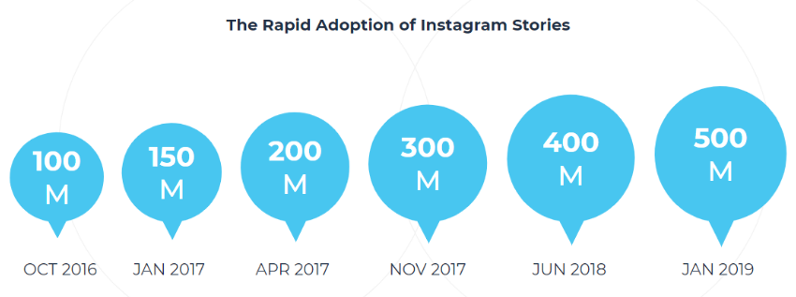

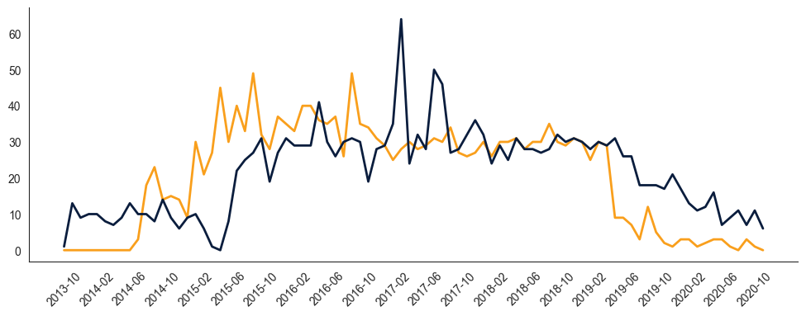

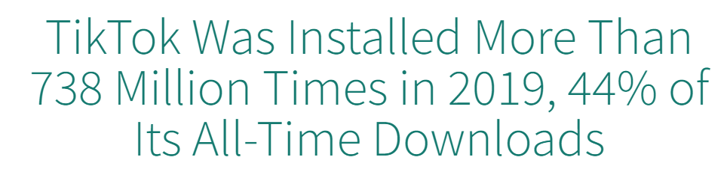
Instagram post activity: a declining trend
General
Comparison
Macro factors
Monthly post evolution
A shift in preference towards
shorter, more personal video content
Decreasing post activity
≈ daily
Posts per month

Slide 6
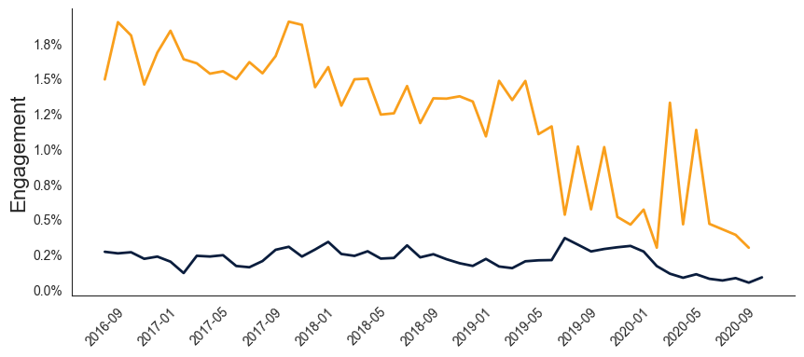
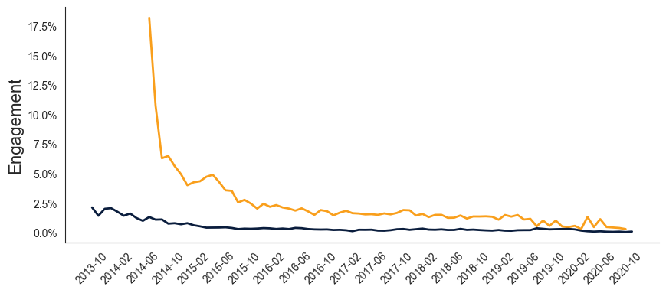

What about engagement?
General
Comparison
Definition¹
= % of followers that liked or commented on a post
Average Engagement
Benchmarks²
2019 (Overall average): 1.10%
2020 (Airline accounts): 2.27%
2021 (Travel accounts): 1.30%
2022 (Travel accounts): 0.91%
2023 (Aviation accounts): 1.07%
2020 Singapore Air: 0.60%
2020 Lufthansa: 0.13%
$$\frac{likes+comments}{followers at time of posting}∗100$$
Monthly average
Decreasing post activity
Both ≈ 500k followers
¹ Based on what is commonly found in literature
² Sources are appended in the references slide

Slide 7

02
Comparing BOTH AIRLINEs’ INSTAGRAM STRATEGY

Slide 8
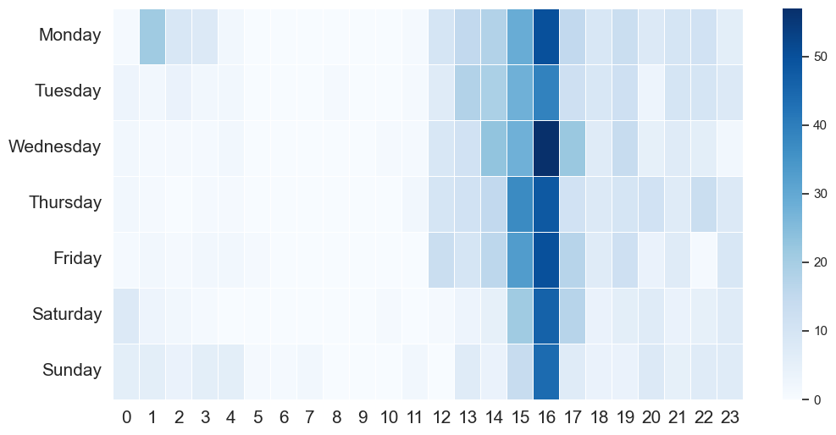
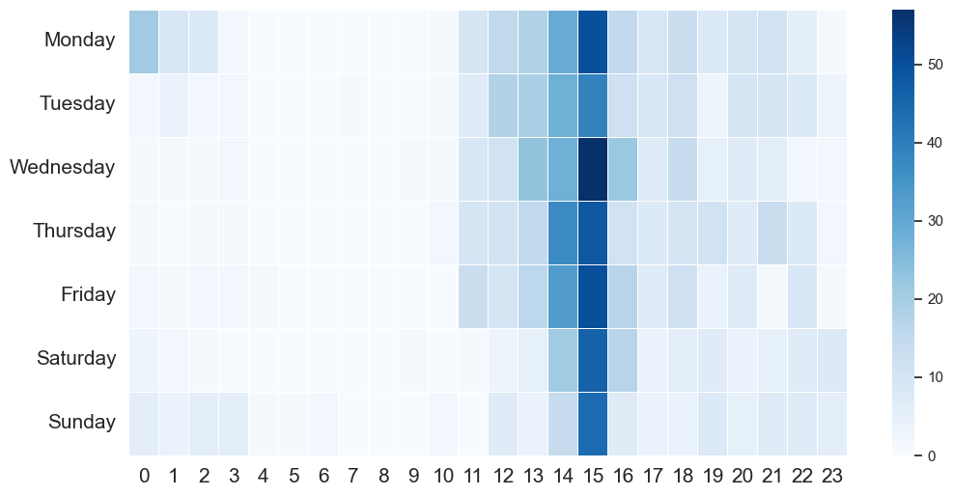

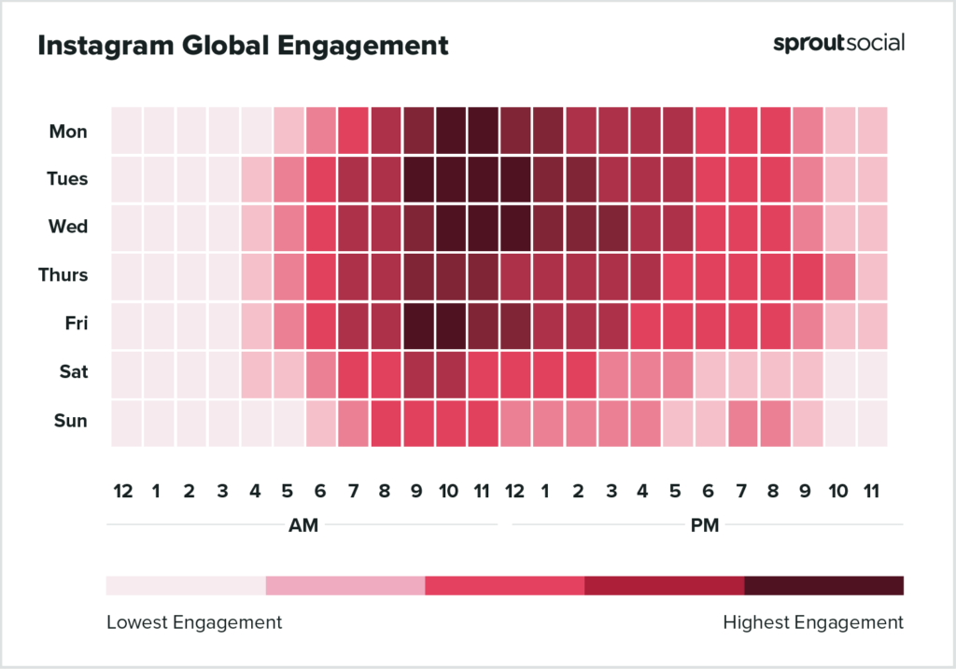
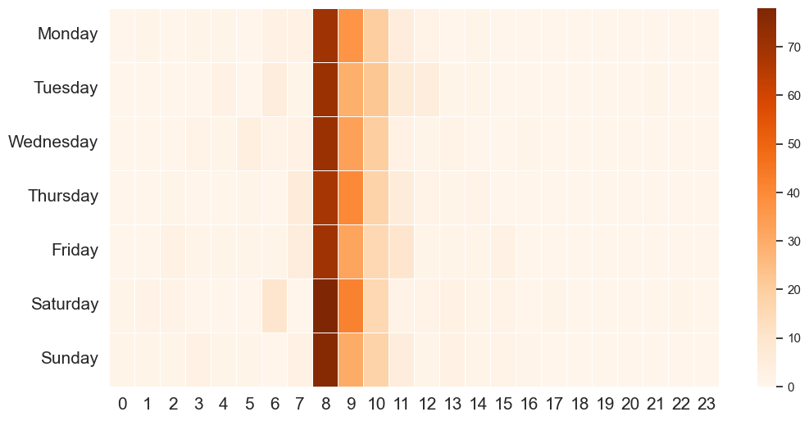
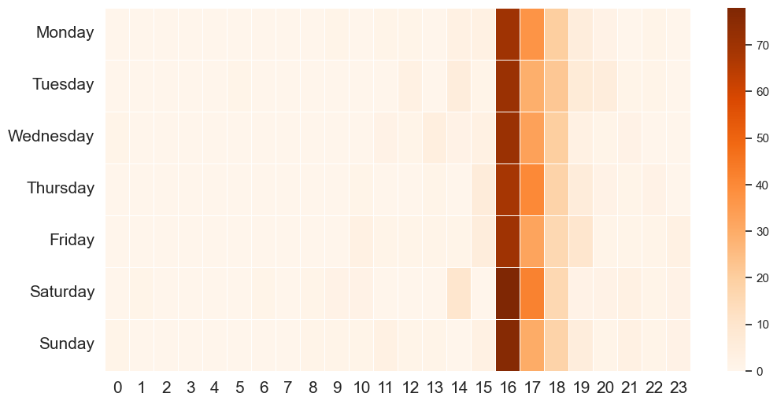


DO WE OBSERVE DIFFERENCES IN post timing?
Strategy
Comparison
Observed engagement on over 34,000 Instagram accounts’ posts¹
(UTC)
(UTC + 1)
Focus on midweek mornings
Avoid posting in weekends
(UTC + 8)
(UTC)
¹ https://sproutsocial.com/insights/best-times-to-post-on-social-media/

Slide 9
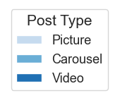
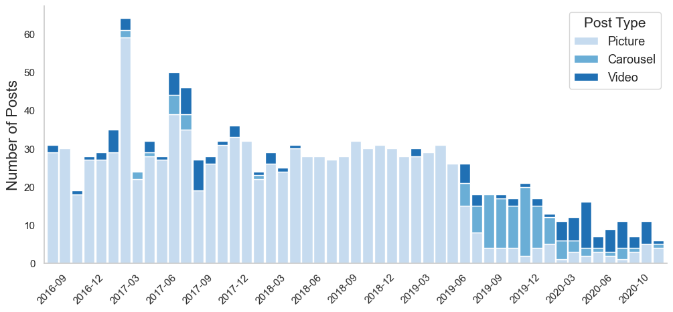
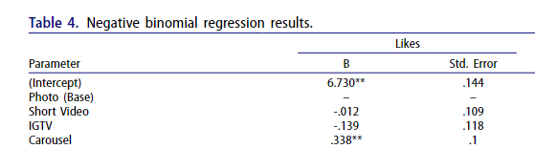
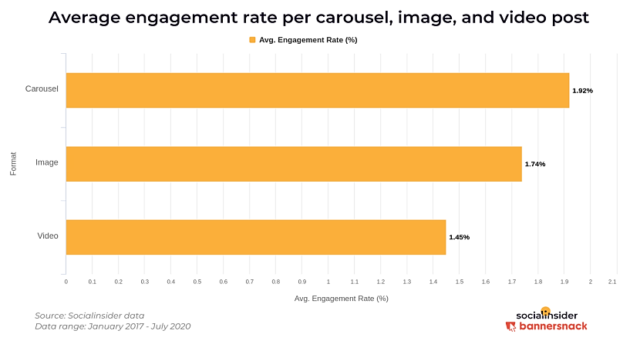
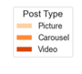
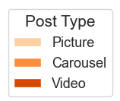
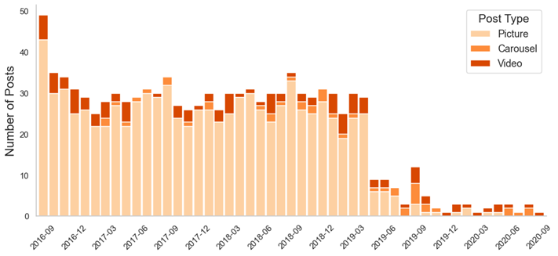
Lufthansa is more experimental in its post types
Strategy
Comparison
Other research on the topic¹
²
¹Risqo , W. M. (n.d.). Factors driving social media engagement on Instagram Https://www.tandfonline.com/doi/full/10.1080/08911762.2021.1956665
²Socialinsider. (n.d.). Instagram Carousel Study - Socialinsider. https://www.socialinsider.io/data-geeks/Instagram-Carousel-Study.pdf

Slide 10


Caption structure and hashtags
Strategy
Comparison
LhCityOfTheMonth
CityOfTheMonth
Heimweh
SayYesToTheWorld
FlySQ
SQfoodie
SQavgeek
UltimateA350Experience
58% Of posts contain hashtags
93% Of posts contain hashtags
Travelling, exploring the world and its cultures
Product quality,
flight experience

Slide 11
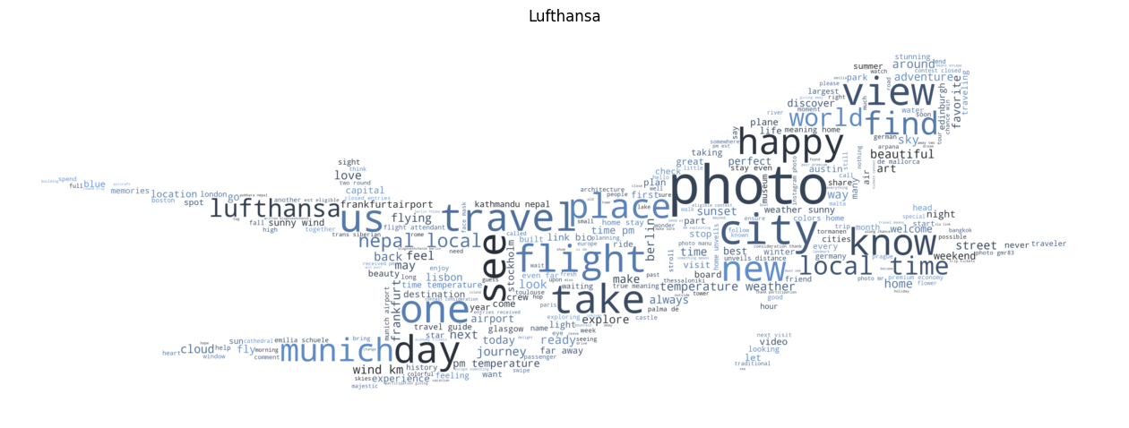
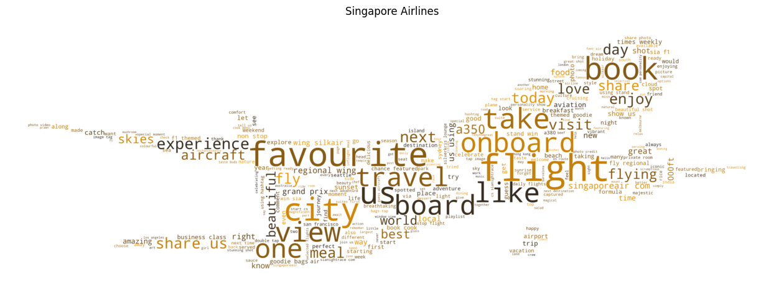
What are both brands talking about?
Strategy
Comparison
Adventure
Travel, place, view, world, city, see …
Follower-taken photos
“Photo by …”
Service & quality
Book, board, experience, meal, onboard, view, flight …
Prompts for comments
“Let us know …”
“Share with us …”

Slide 12


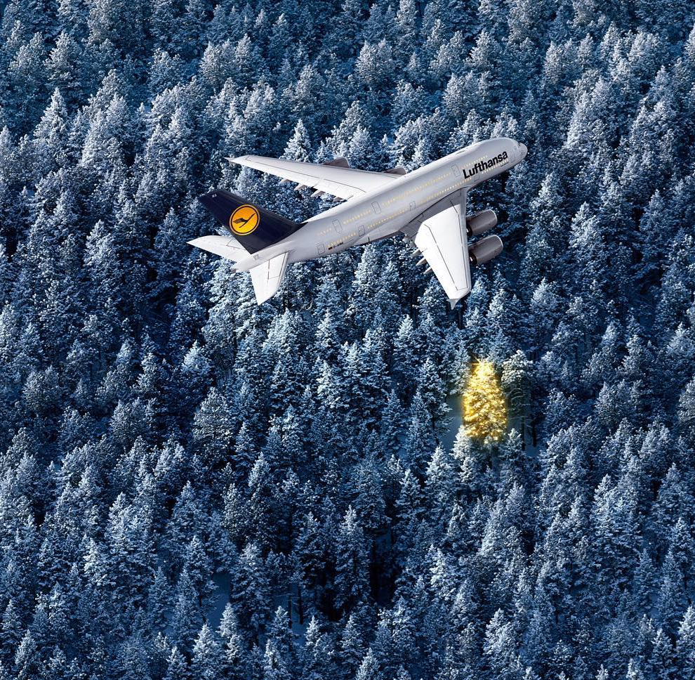
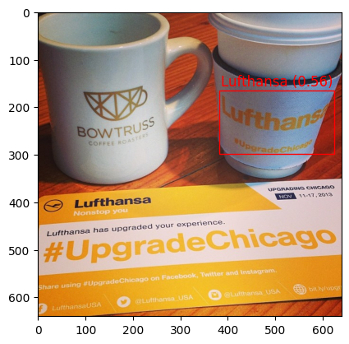
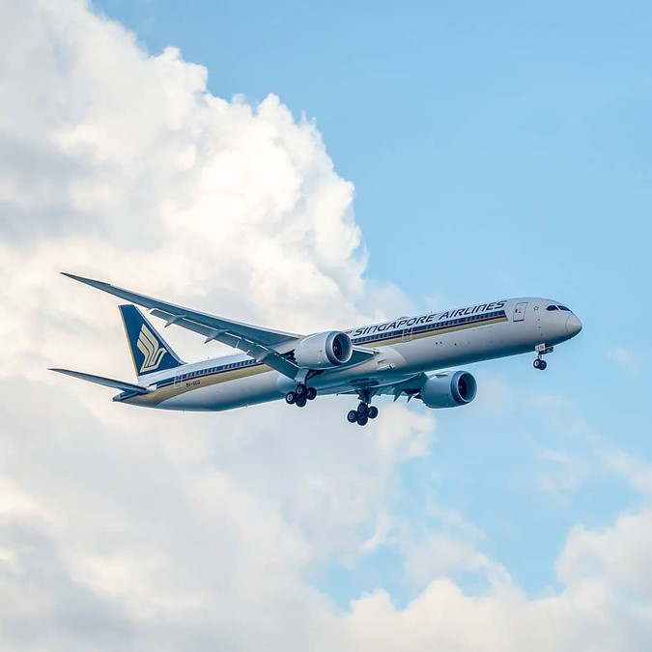
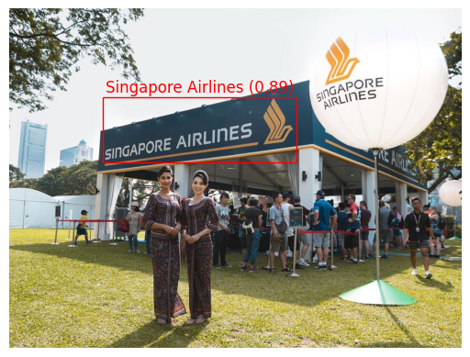
This difference in focus also translates INTO the visuals
Strategy
Comparison
22%
Of posts contain airplanes
10%
Of posts show the brand logo
33%
Of posts contain airplanes
13%
Of posts show the brand logo

Slide 13
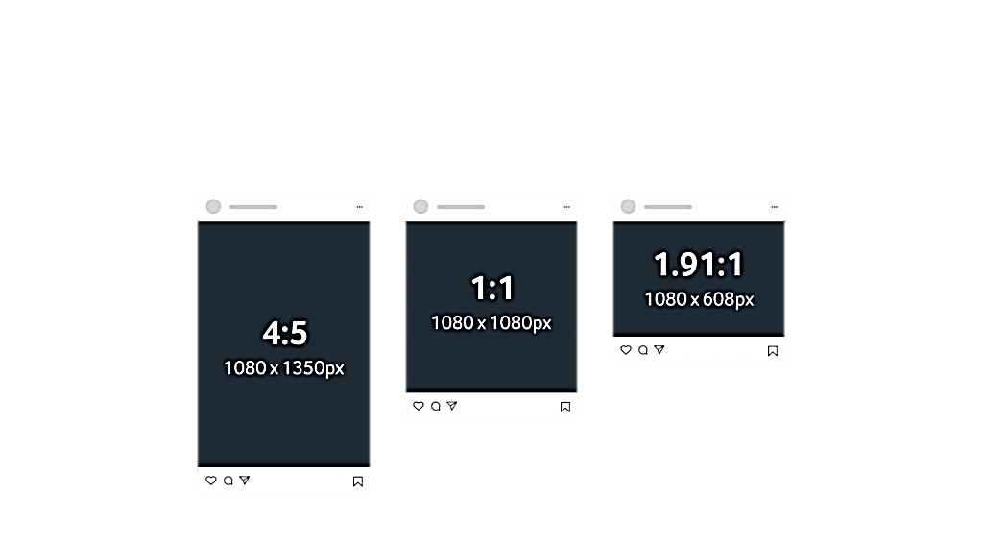

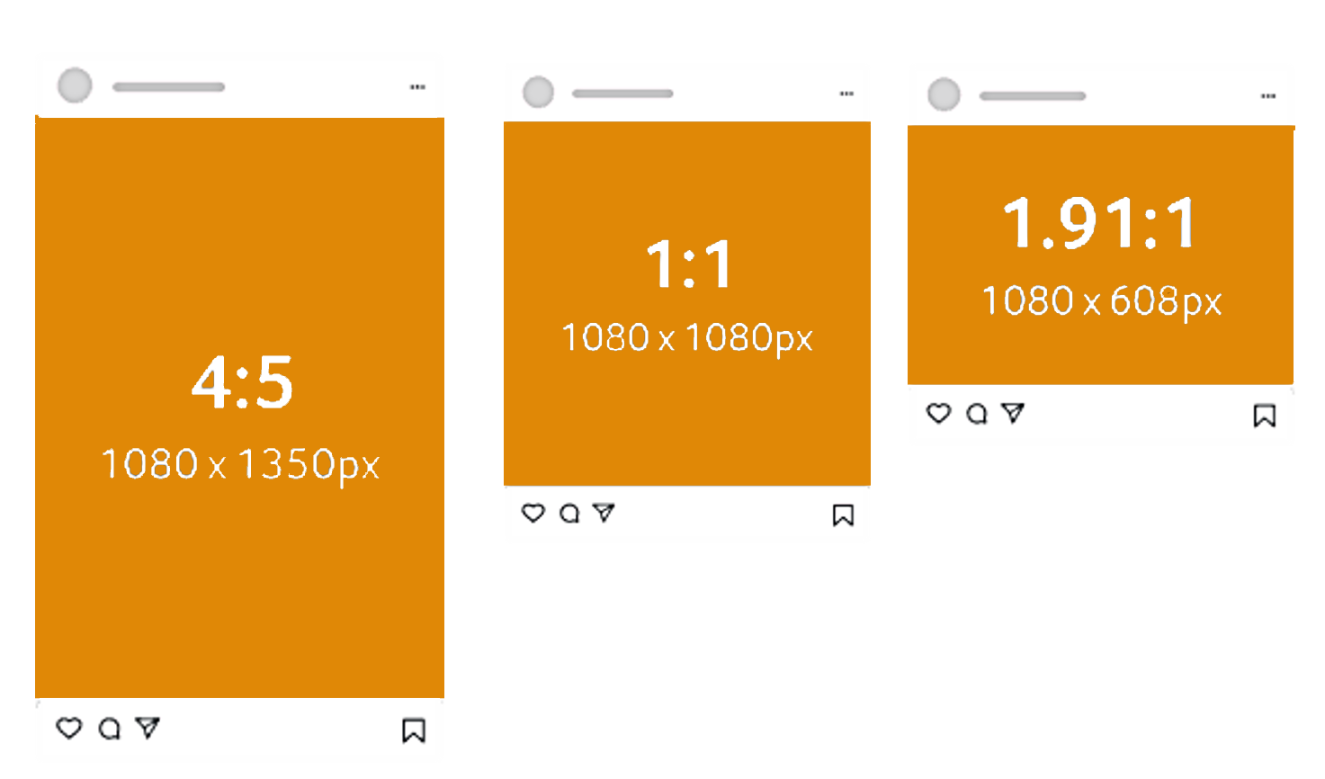
Lufthansa EXPERIMENTS MORE IN ITS ASPECT RATIO’s¹
Strategy
Comparison
24%
Landscape
29%
Landscape
40%
Square
53%
Square
36%
Portrait
18%
Portrait
¹ Kastrenakes, J. (2015, September 27). Portrait is the new square on Instagram. The Verge. https://www.theverge.com/2015/9/27/9398551/instagram-portrait-photos-rule

Slide 14









Lufthansa leverages tagGING more often
Strategy
Comparison
6.44%
of posts explicitly tag other accounts
Of which
18%
are verified
63%
of posts contain tags through an @ in the caption
56%
of posts tag a city
Of which only
22%
in Germany
0.62%
of posts explicitly tag other accounts
Of which
25%
are verified
68%
of posts contain tags through an @ in the caption
2%
of posts tag a city
Of which
93%
in Singapore

Slide 15

03
Identifying The drivers of instagram engagement

Slide 16


























Potential drivers
Engagement Drivers
Insight-Derived
Literature-Based
?
!
ABC
Caption
Contains City Nr. @ Nr. ‘#’ Nr. ‘?’¹ Nr. ‘!’ Contains Link¹ Sentiment² Nr.Words¹ Nr.Tags Subjectivity² Nr.Emojis
Post
Part of Day Season Time Top Post¹ Is Weekday¹ Location Aspect Ratio³ Carousel Vividness¹
ABC
Image
Contains Airplane Contains Logo Nr. Faces⁴ Colourfulness¹ Contains Text
¹ De Vries, L., Gensler, S., & Leeflang, P. S. (2012). Popularity of brand posts on brand fan pages: An investigation of the effects of social media marketing. Journal of interactive marketing, 26(2), 83-91.
² Meire, M., Hewett, K., Ballings, M., Kumar, V., & Van den Poel, D. (2019). The role of marketer-generated content in customer engagement marketing. Journal of Marketing, 83(6), 21-42.
³ Kastrenakes, J. (2015, September 27). Portrait is the new square on Instagram. The Verge. https://www.theverge.com/2015/9/27/9398551/instagram-portrait-photos-rule
⁴ Öhman, W. (2017). Instagram marketing: a study about the effect of visual content on customer engagement in the airline industry (Doctoral dissertation).

Slide 17






Potential drivers
Engagement Drivers
Insight-Derived
Literature-Based
?
!
ABC
Caption
Contains City Nr. @ Nr. ‘#’ Nr. ‘?’¹ Nr. ‘!’ Contains Link¹ Sentiment² Nr.Words¹ Nr.Tags Subjectivity² Nr.Emojis
Post
Part of Day Season Time Top Post¹ Is Weekday¹ Location Aspect Ratio³ Carousel Vividness¹
ABC
Image
Contains Airplane Contains Logo Nr. Faces⁴ Colourfulness¹ Contains Text
¹ De Vries, L., Gensler, S., & Leeflang, P. S. (2012). Popularity of brand posts on brand fan pages: An investigation of the effects of social media marketing. Journal of interactive marketing, 26(2), 83-91.
² Meire, M., Hewett, K., Ballings, M., Kumar, V., & Van den Poel, D. (2019). The role of marketer-generated content in customer engagement marketing. Journal of Marketing, 83(6), 21-42.
³ Kastrenakes, J. (2015, September 27). Portrait is the new square on Instagram. The Verge. https://www.theverge.com/2015/9/27/9398551/instagram-portrait-photos-rule
⁴ Öhman, W. (2017). Instagram marketing: a study about the effect of visual content on customer engagement in the airline industry (Doctoral dissertation).

Slide 18














Potential drivers
Engagement Drivers
Insight-Derived
Literature-Based
?
!
ABC
Caption
Contains City Nr. @ Nr. ‘#’ Nr. ‘?’¹ Nr. ‘!’ Contains Link¹ Sentiment² Nr.Words¹ Nr.Tags Subjectivity² Nr.Emojis
Post
Part of Day Season Time Top Post¹ Is Weekday¹ Location Aspect Ratio³ Carousel Vividness¹
ABC
Image
Contains Airplane Contains Logo Nr. Faces⁴ Colourfulness¹ Contains Text
¹ De Vries, L., Gensler, S., & Leeflang, P. S. (2012). Popularity of brand posts on brand fan pages: An investigation of the effects of social media marketing. Journal of interactive marketing, 26(2), 83-91.
² Meire, M., Hewett, K., Ballings, M., Kumar, V., & Van den Poel, D. (2019). The role of marketer-generated content in customer engagement marketing. Journal of Marketing, 83(6), 21-42.
³ Kastrenakes, J. (2015, September 27). Portrait is the new square on Instagram. The Verge. https://www.theverge.com/2015/9/27/9398551/instagram-portrait-photos-rule
⁴ Öhman, W. (2017). Instagram marketing: a study about the effect of visual content on customer engagement in the airline industry (Doctoral dissertation).

Slide 19
Potential drivers
Engagement Drivers
Insight-Derived
Literature-Based
?
!
ABC
Caption
Contains City Nr. @ Nr. ‘#’ Nr. ‘?’¹ Nr. ‘!’ Contains Link¹ Sentiment² Nr.Words¹ Nr.Tags Subjectivity² Nr.Emojis
Post
Part of Day Season Time Top Post¹ Is Weekday¹ Location Aspect Ratio³ Carousel Vividness¹
ABC
Image
Contains Airplane Contains Logo Nr. Faces⁴ Colourfulness¹ Contains Text
¹ De Vries, L., Gensler, S., & Leeflang, P. S. (2012). Popularity of brand posts on brand fan pages: An investigation of the effects of social media marketing. Journal of interactive marketing, 26(2), 83-91.
² Meire, M., Hewett, K., Ballings, M., Kumar, V., & Van den Poel, D. (2019). The role of marketer-generated content in customer engagement marketing. Journal of Marketing, 83(6), 21-42.
³ Kastrenakes, J. (2015, September 27). Portrait is the new square on Instagram. The Verge. https://www.theverge.com/2015/9/27/9398551/instagram-portrait-photos-rule
⁴ Öhman, W. (2017). Instagram marketing: a study about the effect of visual content on customer engagement in the airline industry (Doctoral dissertation).

Slide 20
Potential drivers
Engagement Drivers
Insight-Derived
Literature-Based
?
!
ABC
Caption
Contains City Nr. @ Nr. ‘#’ Nr. ‘?’¹ Nr. ‘!’ Contains Link¹ Sentiment² Nr.Words¹ Nr.Tags Subjectivity² Nr.Emojis
Post
Part of Day Season Time Top Post¹ Is Weekday¹ Location Aspect Ratio³ Carousel Vividness¹
ABC
Image
Contains Airplane Contains Logo Nr. Faces⁴ Colourfulness¹ Contains Text
¹ De Vries, L., Gensler, S., & Leeflang, P. S. (2012). Popularity of brand posts on brand fan pages: An investigation of the effects of social media marketing. Journal of interactive marketing, 26(2), 83-91.
² Meire, M., Hewett, K., Ballings, M., Kumar, V., & Van den Poel, D. (2019). The role of marketer-generated content in customer engagement marketing. Journal of Marketing, 83(6), 21-42.
³ Kastrenakes, J. (2015, September 27). Portrait is the new square on Instagram. The Verge. https://www.theverge.com/2015/9/27/9398551/instagram-portrait-photos-rule
⁴ Öhman, W. (2017). Instagram marketing: a study about the effect of visual content on customer engagement in the airline industry (Doctoral dissertation).

Slide 21




Potential drivers
Engagement Drivers
Insight-Derived
Literature-Based
?
!
ABC
Caption
Contains City Nr. @ Nr. ‘#’ Nr. ‘?’¹ Nr. ‘!’ Contains Link¹ Sentiment² Nr.Words¹ Nr.Tags Subjectivity² Nr.Emojis
Post
Part of Day Season Time Top Post¹ Is Weekday¹ Location Aspect Ratio³ Carousel Vividness¹
ABC
Image
Contains Airplane Contains Logo Nr. Faces⁴ Colourfulness¹ Contains Text
¹ De Vries, L., Gensler, S., & Leeflang, P. S. (2012). Popularity of brand posts on brand fan pages: An investigation of the effects of social media marketing. Journal of interactive marketing, 26(2), 83-91.
² Meire, M., Hewett, K., Ballings, M., Kumar, V., & Van den Poel, D. (2019). The role of marketer-generated content in customer engagement marketing. Journal of Marketing, 83(6), 21-42.
³ Kastrenakes, J. (2015, September 27). Portrait is the new square on Instagram. The Verge. https://www.theverge.com/2015/9/27/9398551/instagram-portrait-photos-rule
⁴ Öhman, W. (2017). Instagram marketing: a study about the effect of visual content on customer engagement in the airline industry (Doctoral dissertation).

Slide 22
Potential drivers
Engagement Drivers
Insight-Derived
Literature-Based
?
!
ABC
Caption
Contains City Nr. @ Nr. ‘#’ Nr. ‘?’¹ Nr. ‘!’ Contains Link¹ Sentiment² Nr.Words¹ Nr.Tags Subjectivity² Nr.Emojis
Post
Part of Day Season Time Top Post¹ Is Weekday¹ Location Aspect Ratio³ Carousel Vividness¹
ABC
Image
Contains Airplane Contains Logo Nr. Faces⁴ Colourfulness¹ Contains Text
¹ De Vries, L., Gensler, S., & Leeflang, P. S. (2012). Popularity of brand posts on brand fan pages: An investigation of the effects of social media marketing. Journal of interactive marketing, 26(2), 83-91.
² Meire, M., Hewett, K., Ballings, M., Kumar, V., & Van den Poel, D. (2019). The role of marketer-generated content in customer engagement marketing. Journal of Marketing, 83(6), 21-42.
³ Kastrenakes, J. (2015, September 27). Portrait is the new square on Instagram. The Verge. https://www.theverge.com/2015/9/27/9398551/instagram-portrait-photos-rule
⁴ Öhman, W. (2017). Instagram marketing: a study about the effect of visual content on customer engagement in the airline industry (Doctoral dissertation).

Slide 23



drivers
Engagement Drivers
Contains Airplane
Colourfulness
Number of Tags
Contains Brand Logo

Slide 24
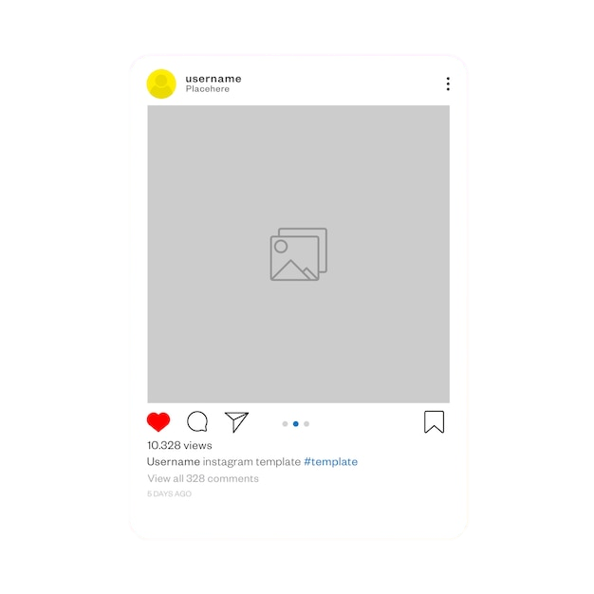

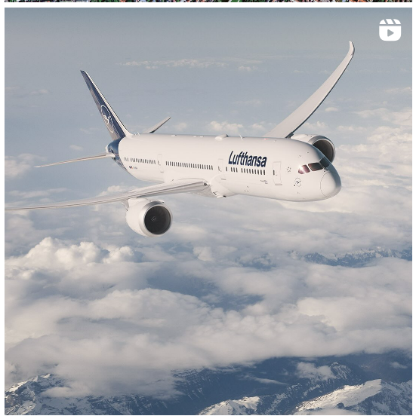
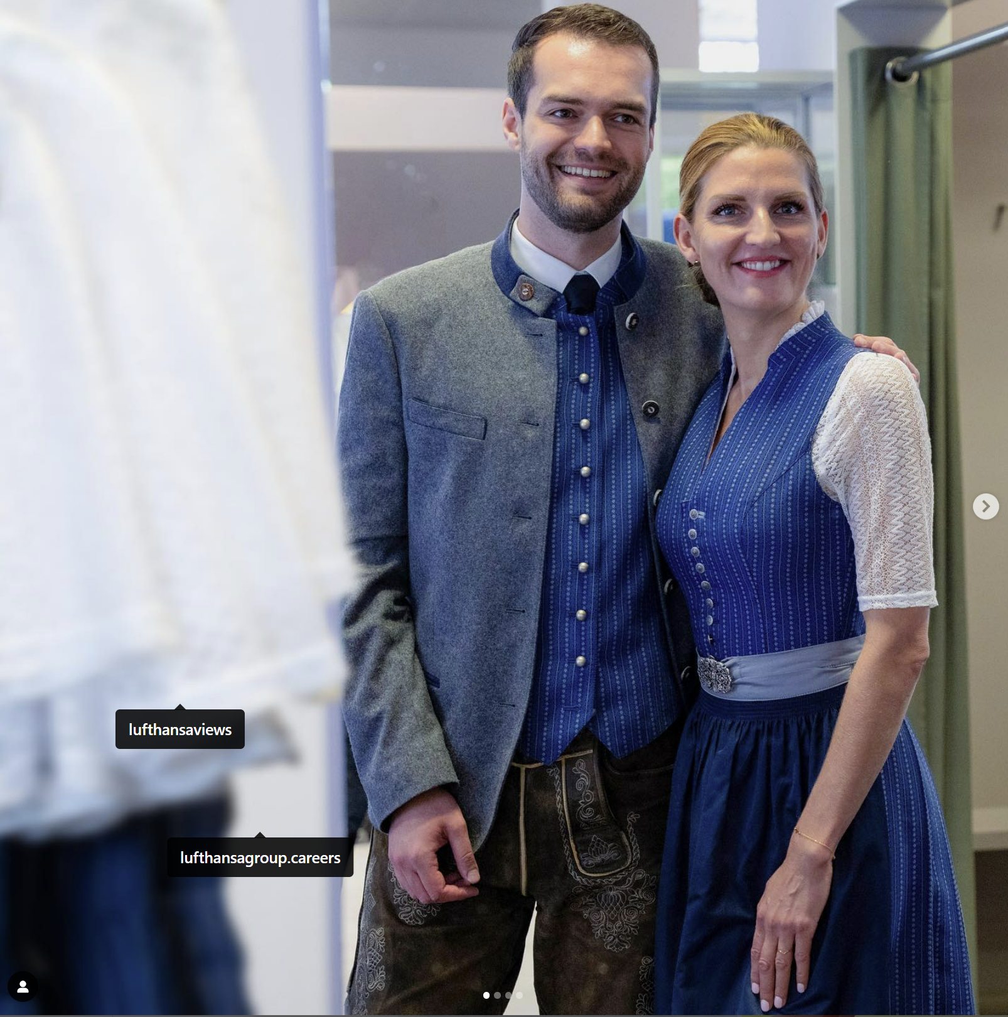
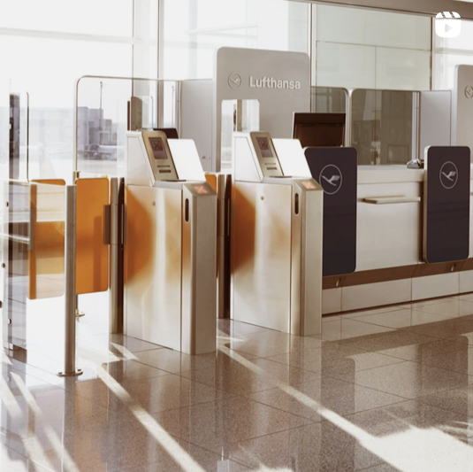
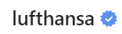
Our recommendations
post MORE pictures with a Visible brand logo and planes
Remember to tag users to highlight their work
Incorporate less colour into your photos NOT TO overwhelm your audience

Slide 25

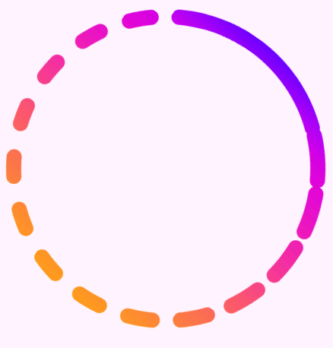



FURTHER STEPS
New forms of social media
Provide us with data regarding
TikTok Instagram Stories Instagram Reels
Analyse impact
influencer posts

Slide 26
TECHNICAL REPORT
03
Dependent variables & features
Preprocessing
Modelling intricacies (RFE, non-stationarity)
Models used & evaluation

Slide 27

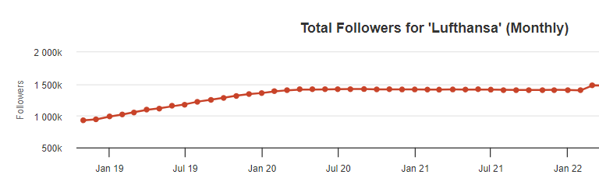
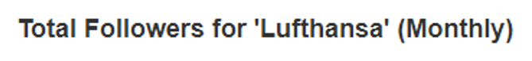


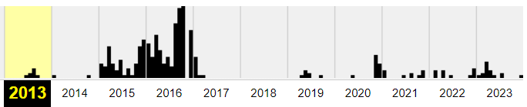
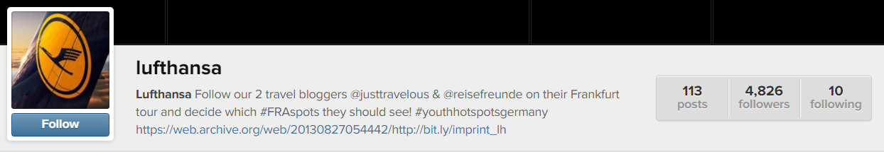
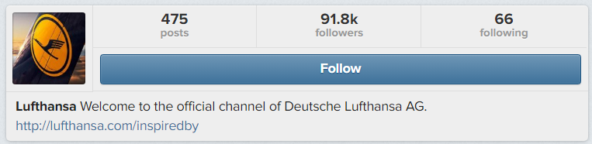

NUMBER OF FOLLOWERS
$$Engagement= \frac{likes+comments}{followers at time of posting}∗100$$
Problem: followers at time of posting = followers at time of scraping = constant
→ We need follower data from March 2013 – December 2020
But: only until end of 2018
Followers over time
August 2013
March 2015

Slide 28
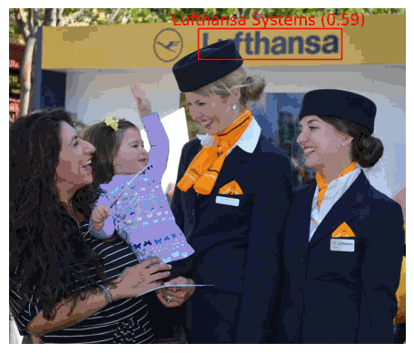
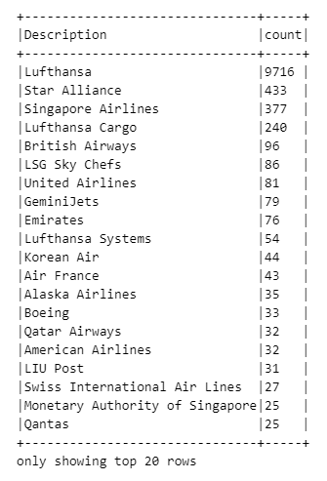
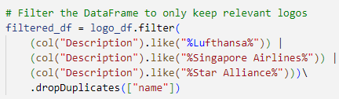

Feature: Has_Brand_logo
Reasoning: Including a brand logo can signify the main subject of the content, potentially suggesting a commercial intent behind the post.
Step 1: Google Vision API — Logo Detection
Step 2: Filter
Step 3: has_brand_logo feature
if picture has at least one of the specified Logo’s

Slide 29

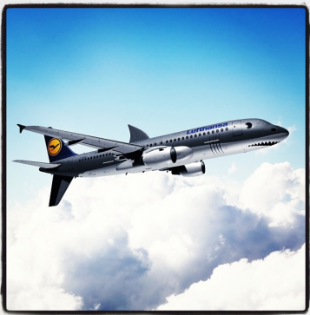
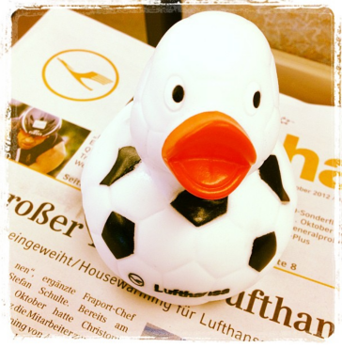
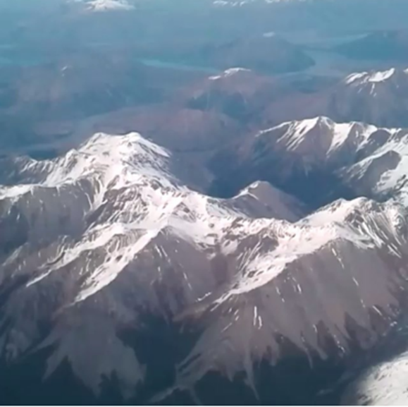
FEATURES: HAS_AIRPLANE (part1)
Step 1: Use Google Vision API — Generate Descriptions
30 most frequent as dummies
Post_id | Water | Sky | …
20xx_yy_yy | 1 | 0 | …
20yy_yy_yy | 1 | 1 | …
… | … | … | …
Input
Output
1. Water (0.96)
…
10. Sky (0.78)
24 000+ images
Google Vision API
Step 2: Construct training data
JOIN
Training data
Manual labelling
Post_id | Has_airplane
20xx_yy_yy | 1
20yy_yy_yy | 0
… | …
Post_id | Water | Sky | … | Has_airplane
20xx_yy_yy | 1 | 0 | … | 1
20yy_yy_yy | 1 | 1 | … | 0
… | … | … | … | …
Random subset of 2200 images
Step 3: Create classification model that predicts has_airplane based on descriptions
Train-validation-test split 0.56-0.24-0.20
Random Forest — Decision Tree — Logistic Regression

Slide 30
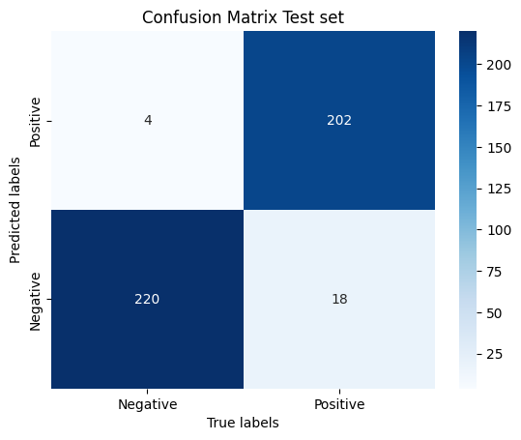
FEATURES: HAS_AIRPLANE (Part 2)
Step 4: Deduct best alternative on validation set — Logistic Regression with 25 most frequent descriptions
Step 5: Evaluation of performance
Step 6: Apply on remaining data
Step 7: Use as feature in engagement model
 | Validation set | Test set
Accuracy | 0.9728 | 0.9807
Precision | 0.9569 | 0.9806
Recall | 0.9136 | 0.9181

Slide 31
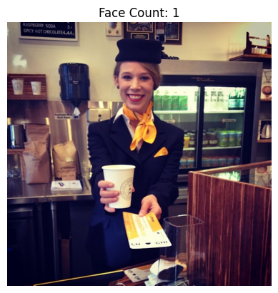
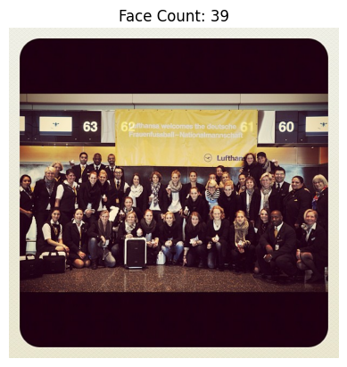
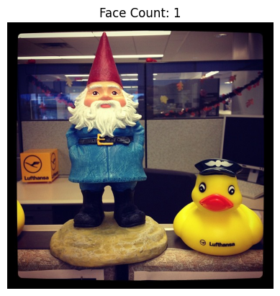
FEATURES: nr_faces¹
Reasoning: Including people in pictures fosters human connection and relatability, utilizing the emotional impact of facial expressions to boost engagement by resonating with viewers' emotions.
Not perfect!
²Bakhshi, S., Shamma, D. A., & Gilbert, E. (2014). Faces engage us: photos with faces attract more likes and comments on Instagram. CHI '14: Proceedings of the SIGCHI Conference on Human Factors in Computing Systems, 965–974. https://doi.org/10.1145/2556288.2557403
¹Using MTCNN package in Python: https://pypi.org/project/mtcnn/

Slide 32






FEATURES: contains_city
Reasoning: Lufthansa often mentions cities and uses tags such as #lhcityofthemonth. Chauvinism of followers of the mentioned region might generate a higher engagement
Method 1: Matching with external database
Method 2: Named Entity Recognition (NER)
44k+ cities

Slide 33



Feature selection
Recursive Feature Elimination (RFE)
No support for PySpark → Implemented through scikit (Python)
RFE
14 variables
BUT: Selection did not seem robust (different variables each time)
→ Discontinued feature selection

Slide 34





DATA CUT-OFF
Word2Vec
Vector-Assembler
Standard-Scaler
Vector-Assembler
Model
Vector-Assembler
String-Indexer
Textual features
Categorical features
Numerical features
Numerical features
ALL features
Linear Baseline
Decision Tree
Random Forest
XGBoost
AutoGluon
Cut-off in September 2016: data before it clearly shows trend and makes data unstationary
TRAIN
(80%)
TEST
(20%)
Autocorrelation better, but let’s still perform a time-based split

Slide 35
Pipeline setup
Word2Vec
Vector-Assembler
Standard-Scaler
Vector-Assembler
Model
Vector-Assembler
String-Indexer
Textual features
Categorical features
Numerical features
Numerical features
ALL features
Linear Baseline
Decision Tree
Random Forest
XGBoost
AutoGluon

Slide 36
HYPErparameter tuning
Linear Regression
Decision Tree
Random Forest
Gradient Boosting
Regparam
[0,0.1,0.05,0.01,0.005,0.001]
ElasticNet
[0, 0.5, 1]
MaxDepth
[3,5,8,15,20,30]
MinInstancesPerNode
[1, 5, 10, 25,50, 100]
MinInfoGain
[0, 0.1]
MaxBins
[16,32]
MaxDepth
[2,3,5,7]
MinInstancesPerNode
[1,5,10]
featureSubsetStrategy
[p/3]
subsamplingRate
[0.5,0.75,1]
numTrees
[150]
MaxDepth
[2,4,6]
MaxIter
[10,20,30,50,100]
stepSize
[0.1]
MaxBins
[32]

Slide 37
MODEL COMPARISON
Based on cross-validation score
Model | RMSE
Linear Regression | 0.1112
Decision Tree | 0.0953
Gradient Boosting | 0.0933
Random Forest | 0.0911
AutoGluon | 0.0817
Best model score on test set
Model | RMSE | MSE | MAE | R²
AutoGluon | 0.1600 | 0.0256 | 0.0978 | 0.4405

Slide 38

SHAP — AutoGluon

Slide 39
FURTHER CONSIDERATIONS / improvements
Engagement rate calculations currently include only initial comments
Replies were not included, this should be done to be fully correct
On average this raises the number of comments by 8.3%
BUT: after deducting company responses (not considered follower engagement), only 6.4%
Still some autocorrelation / non-stationarity in the data when modelling
Make scores on the test set a lot worse, should be explored
Note: explored time differencing but with little good results
Sentiment comments not included
Focus on drivers the company can directly influence (but found to be relevant in literature)

Slide 40
THANK you for your attention
DO YOU HAVE ANY QUESTIONS?
Ballegeer Matteo 01900129
De Rocker Yaël 01904043
Janssens Wannes 01905583
Peire Julian 01900199
Willemen Tom 01900194

Slide 41
SUPPORTING SLIDES

Slide 42


Feature importance Lufthansa usa

Slide 43

Feature importance Lufthansa usa (continued)

Slide 44


Feature importance Singapore air

Slide 45

Feature importance Singapore air (continued)

Slide 46

Shapley Singapore air

Slide 47

Engagement valence

